Slide 1
Programming with Python
Day 11

Slide 2
Measuring the Efficiency of Algorithms
What is an algorithm?
When choosing algorithms, we often have to settle for a space/time tradeoff
An algorithm can be designed to gain faster run times at the cost of using extra space (memory), or the other way around
Memory is now quite inexpensive for desktop and laptop computers, but not yet for miniature devices

Slide 3
Measuring the Run Time of an Algorithm
One way to measure the time cost of an algorithm is to use computer’s clock to obtain actual run time
Benchmarking or profiling
In Python you can use time() in time module
Returns number of seconds that have elapsed between current time on the computer’s clock and start of the “epoch” (January 1, 1970)

Slide 4
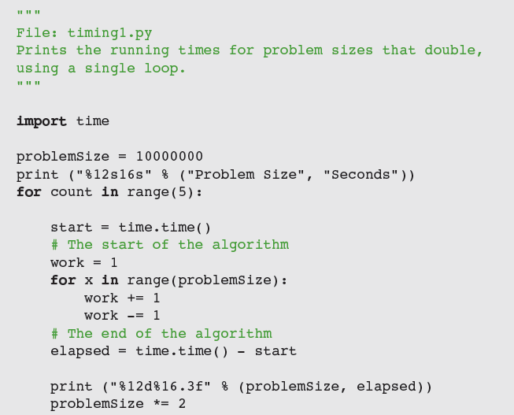
Measuring the Run Time of an Algorithm

Slide 5
Measuring the Run Time of an Algorithm

Slide 6
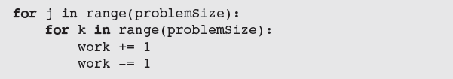
Measuring the Run Time of an Algorithm

Slide 7
Measuring the Run Time of an Algorithm
This method permits accurate predictions of the running times of many algorithms
Problems:
Different hardware platforms have different processing speeds, so the running times of an algorithm differ from machine to machine
Running time varies with OS and programming language too
It is impractical to determine the running time for some algorithms with very large data sets

Slide 8
Counting Instructions
Another technique is to count the instructions executed with different problem sizes
We count the instructions in the high-level code in which the algorithm is written, not instructions in the executable machine language program
Distinguish between:
Instructions that execute the same number of times regardless of problem size
For now, we ignore instructions in this class
Instructions whose execution count varies with problem size

Slide 9
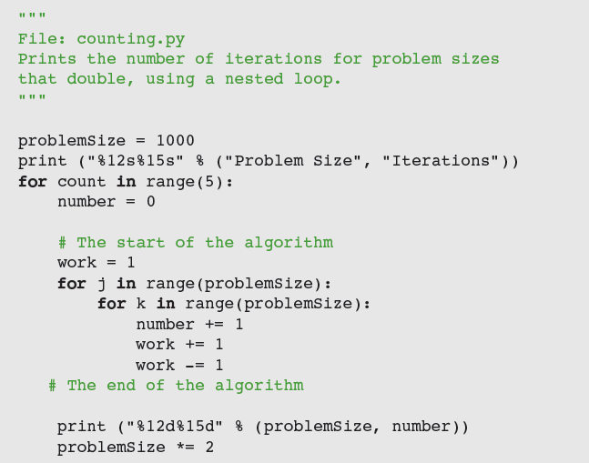
Counting Instructions

Slide 10
Counting Instructions

Slide 11
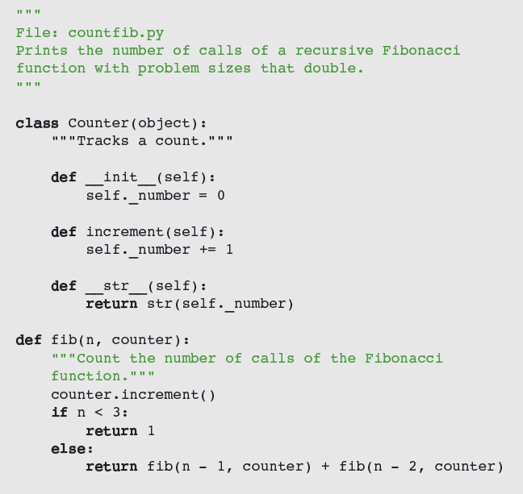
Counting Instructions

Slide 12
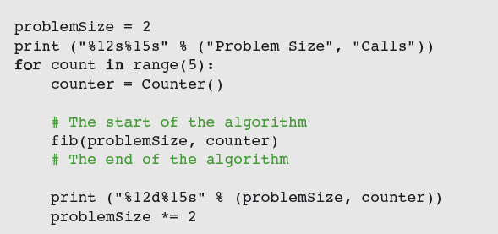
Counting Instructions

Slide 13
Measuring the Memory Used by an Algorithm
A complete analysis of the resources used by an algorithm includes the amount of memory required
We focus on rates of potential growth
Some algorithms require the same amount of memory to solve any problem
Other algorithms require more memory as the problem size gets larger

Slide 14
Complexity Analysis
Complexity analysis entails reading the algorithm and using pencil and paper to work out some simple algebra
Used to determine efficiency of algorithms
Allows us to rate them independently of platform-dependent timings or impractical instruction counts

Slide 15
Orders of Complexity
Consider the two counting loops discussed earlier:
When we say “work,” we usually mean the number of iterations of the most deeply nested loop

Slide 16
Orders of Complexity
The performances of these algorithms differ by what we call an order of complexity
The first algorithm is linear
The second algorithm is quadratic

Slide 17
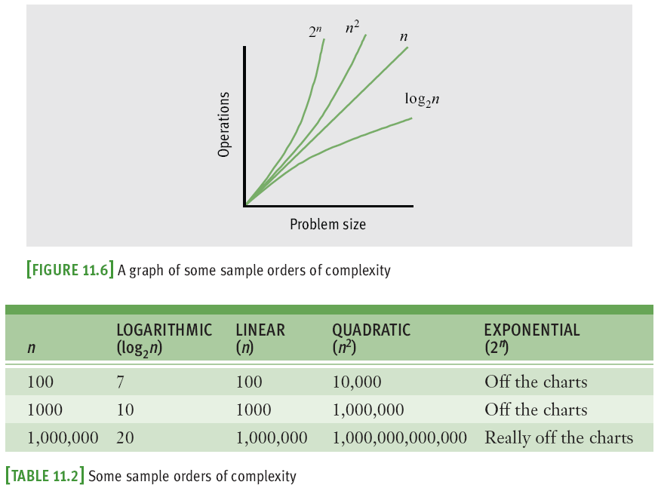
Orders of Complexity

Slide 18
Big-O Notation
The amount of work in an algorithm typically is the sum of several terms in a polynomial
We focus on one term as dominant
As n becomes large, the dominant term becomes so large that the amount of work represented by the other terms can be ignored
Asymptotic analysis
Big-O notation: used to express the efficiency or computational complexity of an algorithm

Slide 19
Exercise
Measure the amount of time it takes to execute one of your previously written Python applications. Run the measurements several time to determine the average.
Research how to measure memory consumption using Python on your operating system (the methods are different). Implement one of the memory measuring techniques in one of your previously written applications.

Slide 20
Search Algorithms
We now present several algorithms that can be used for searching and sorting lists
We first discuss the design of an algorithm,
We then show its implementation as a Python function, and,
Finally, we provide an analysis of the algorithm’s computational complexity
To keep things simple, each function processes a list of integers

Slide 21
Search for a Minimum
Python’s min function returns the minimum or smallest item in a list
Alternative version:
n – 1 comparisons for a list of size n
O(n)

Slide 22
Linear Search of a List
Python’s in operator is implemented as a method named __contains__ in the list class
Uses a sequential search or a linear search
Python code for a linear search function:

Slide 23
Best-Case, Worst-Case, and Average-Case Performance
Analysis of a linear search considers three cases:
In the worst case, the target item is at the end of the list or not in the list at all
O(n)
In the best case, the algorithm finds the target at the first position, after making one iteration
O(1)
Average case: add number of iterations required to find target at each possible position; divide sum by n
O(n)

Slide 24
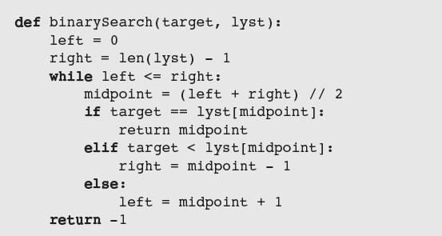
Binary Search of a List
A linear search is necessary for data that are not arranged in any particular order
When searching sorted data, use a binary search

Slide 25
Binary Search of a List
More efficient than linear search
Additional cost has to do with keeping list in order

Slide 26
Comparing Data Items
To allow algorithms to use comparison operators with a new class of objects, define the __eq__, __lt__, and __gt__ methods in that class
Header: def __it__(self, other):
Should return:
0 when the two objects are equal
A number less than 0 if self < other
A number greater than 0 if self > other

Slide 27
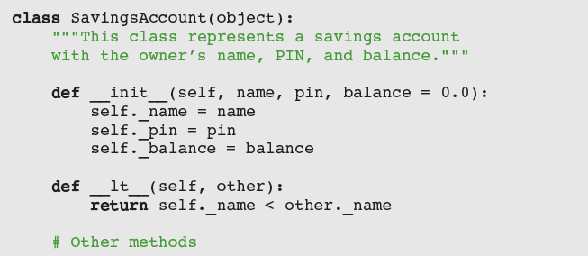
Comparing Data Items

Slide 28
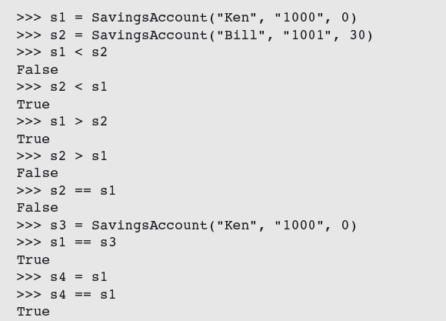
Comparing Data Items

Slide 29
Sort Algorithms
The sort functions that we develop here operate on a list of integers and uses a swap function to exchange the positions of two items in the list

Slide 30
Selection Sort
Perhaps the simplest strategy is to search the entire list for the position of the smallest item
If that position does not equal the first position, the algorithm swaps the items at those positions

Slide 31
Selection Sort
Selection sort is O(n²) in all cases
For large data sets, the cost of swapping items might also be significant
This additional cost is linear in worst/average cases

Slide 32
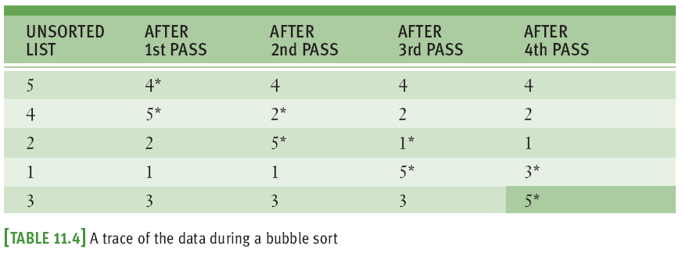
Bubble Sort
Starts at beginning of list and compares pairs of data items as it moves down to the end
When items in pair are out of order, swap them

Slide 33
Bubble Sort
Bubble sort is O(n²)
Will not perform any swaps if list is already sorted
Worst-case behavior for exchanges is greater than linear
Can be improved, but average case is still O(n²)

Slide 34
Insertion Sort
Worst-case behavior of insertion sort is O(n²)

Slide 35
Insertion Sort
The more items in the list that are in order, the better insertion sort gets until, in the best case of a sorted list, the sort’s behavior is linear
In the average case, insertion sort is still quadratic

Slide 36
Best-Case, Worst-Case, and Average-Case Performance Revisited
Thorough analysis of an algorithm’s complexity divides its behavior into three types of cases:
Best case
Worst case
Average case
There are algorithms whose best-case and average-case performances are similar, but whose performance can degrade to a worst case
When choosing/developing an algorithm, it is important to be aware of these distinctions

Slide 37
An Exponential Algorithm: Recursive Fibonacci

Slide 38
An Exponential Algorithm: Recursive Fibonacci
Exponential algorithms are generally impractical to run with any but very small problem sizes
Recursive functions that are called repeatedly with same arguments can be made more efficient by technique called memoization
Program maintains a table of the values for each argument used with the function
Before the function recursively computes a value for a given argument, it checks the table to see if that argument already has a value

Slide 39
Converting Fibonacci to a Linear Algorithm
Pseudocode:
Set sum to 1
Set first to 1
Set second to 1
Set count to 3
While count <= N
Set sum to first + second
Set first to second
Set second to sum
Increment count

Slide 40
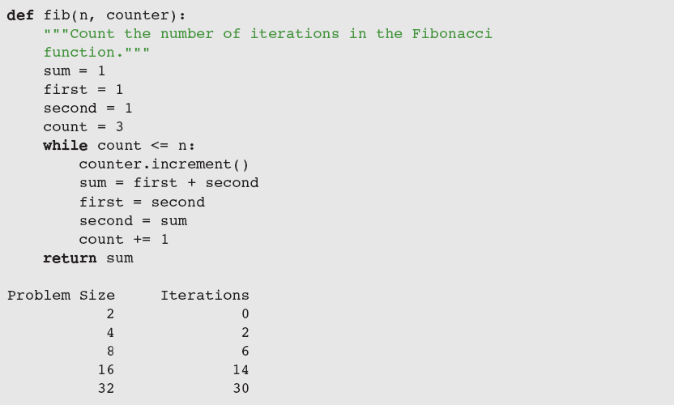
Converting Fibonacci to a Linear Algorithm

Slide 41
Case Study: An Algorithm Profiler
Profiling: measuring an algorithm’s performance, by counting instructions and/or timing execution
Request:
Write a program to allow profiling of sort algorithms
Analysis:
Configure a sort algorithm to be profiled as follows:
Define sort function to receive a Profiler as a 2nd parameter
In algorithm’s code, run comparison() and exchange() with the Profiler object where relevant, to count comparisons and exchanges

Slide 42
Case Study: An Algorithm Profiler

Slide 43
Case Study: An Algorithm Profiler
Design:
Two modules:
profiler—defines the Profiler class
algorithms—defines the sort functions, as configured for profiling
Implementation (Coding):
Next slide shows a partial implementation of the algorithms module

Slide 44
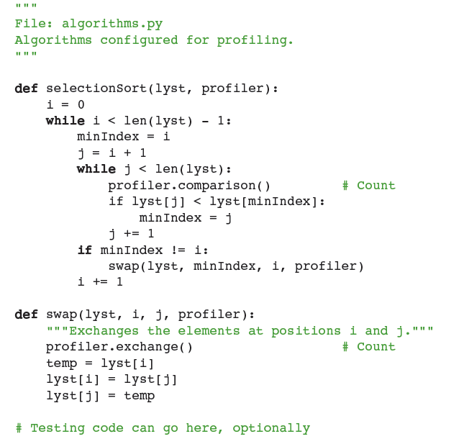
Case Study: An Algorithm Profiler

Slide 45
Summary
Different algorithms can be ranked according to time and memory resources that they require
Running time of an algorithm can be measured empirically using computer’s clock
Counting instructions provides measurement of amount of work that algorithm does
Rate of growth of algorithm’s work can be expressed as a function of the size of its problem instances
Big-O notation is a common way of expressing an algorithm’s runtime behavior

Slide 46
Summary
Common expressions of run-time behavior are O(log₂n), O(n), O(n²), and O(k^{n})
An algorithm can have different best-case, worst-case, and average-case behaviors
In general, it is better to try to reduce the order of an algorithm’s complexity than it is to try to enhance performance by tweaking the code
Binary search is faster than linear search (but data must be ordered)
Exponential algorithms are impractical to run with large problem sizes

Slide 47
Exercise
Use the first line from the US Constitution as input
“We the People of the United States, in Order to form a more perfect Union, establish Justice, insure domestic Tranquility, provide for the common defence, promote the general Welfare, and secure the Blessings of Liberty to ourselves and our Posterity, do ordain and establish this Constitution for the United States of America.”
Write a function that returns all letters of the input string in alphabetical order
Write another function that returns all words of the input string sorted by word length.

